Slide 1

Chapter 04- [2]
Playing with components
Notes:
Session: Ghi số thứ tự session trong môn học
Session Name: ghi tên của session sẽ dạy

Slide 2
Objectives
In this chapter, we'll go through a number of new and existing components:
Using the button component
Coding forms in Bootstrap 4
Using the Jumbotron component
Using Cards for layout
How to use the Navs component
Notes:
Mô tả nội dung mà học viên phải đạt được khi kết thúc môn học này

Slide 3
Using the button component
Notes:
Session: Ghi số thứ tự session trong môn học
Session Name: ghi tên của session sẽ dạy

Slide 4
Using the button component
Buttons are one of the most commonly used components in Bootstrap. In version 4 of Bootstrap, some of the new options for the button component include an outlined variation, toggle states, and button groups with checkboxes and radios.

Slide 5
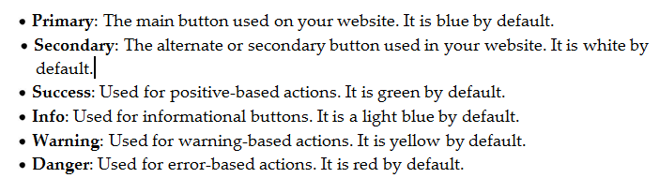
Basic button examples
Bootstrap comes with six different button color options out of the box.

Slide 6
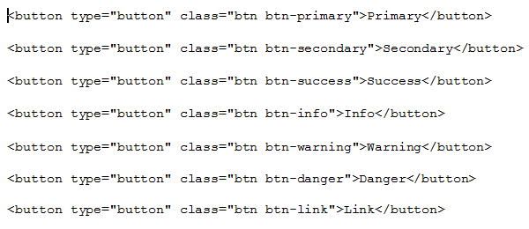

Basic button examples

Slide 7
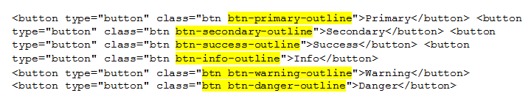

Creating outlined buttons
Basically, you just need to append -outline to the default button variation class name. Once you do, your buttons should look like this:

Slide 8
Using button groups
Notes:
Session: Ghi số thứ tự session trong môn học
Session Name: ghi tên của session sẽ dạy

Slide 9
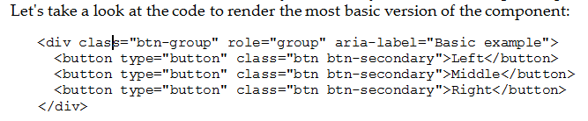

Using button groups
If you're new to Bootstrap, button groups are exactly as they sound. They are a group of buttons that are connected horizontally or vertically to look like a single component.

Slide 10


Creating vertical button groups
There is no need to change any of the code on the <button> tags, you just need to update the CSS class name on the wrapping <div> tag. Here's the code you need to change:

Slide 11
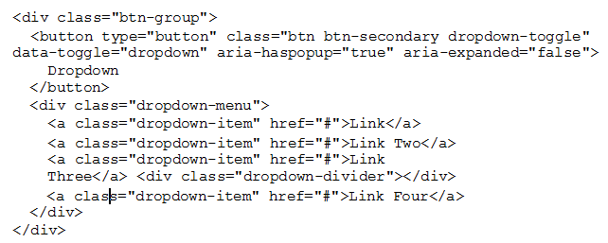
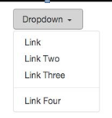
Coding a button dropdown
Let's take a look at the code required to render a basic drop-down button:

Slide 12

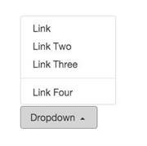
Creating a pop-up menu
In some cases, you might want to have your menu pop up above the button instead of below it:

Slide 13
Coding forms in Bootstrap 4
Notes:
Session: Ghi số thứ tự session trong môn học
Session Name: ghi tên của session sẽ dạy

Slide 14


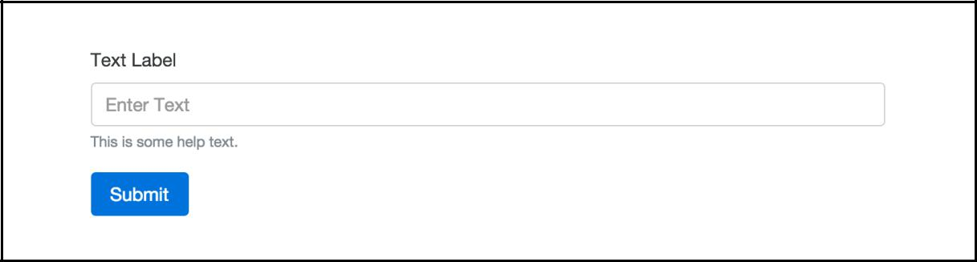
Setting up a form
Let's start with the basics and create a form following those requirements. Here's the code to get you started:

Slide 15
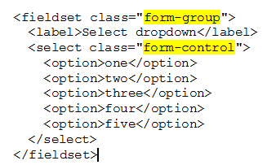
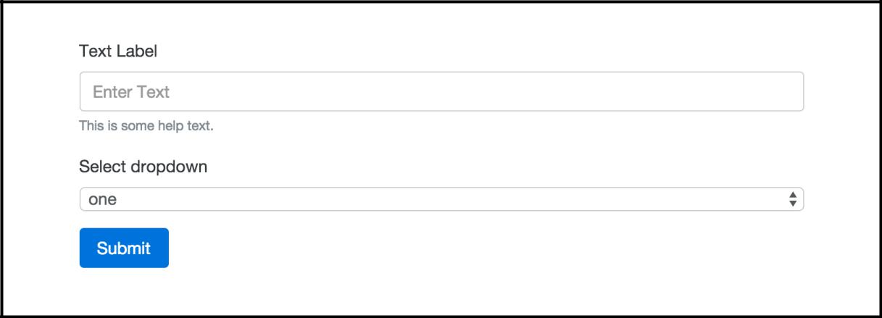
Adding a select dropdown
Let's build on our form code by adding a select drop-down menu. Insert the following code after our text input:

Slide 16

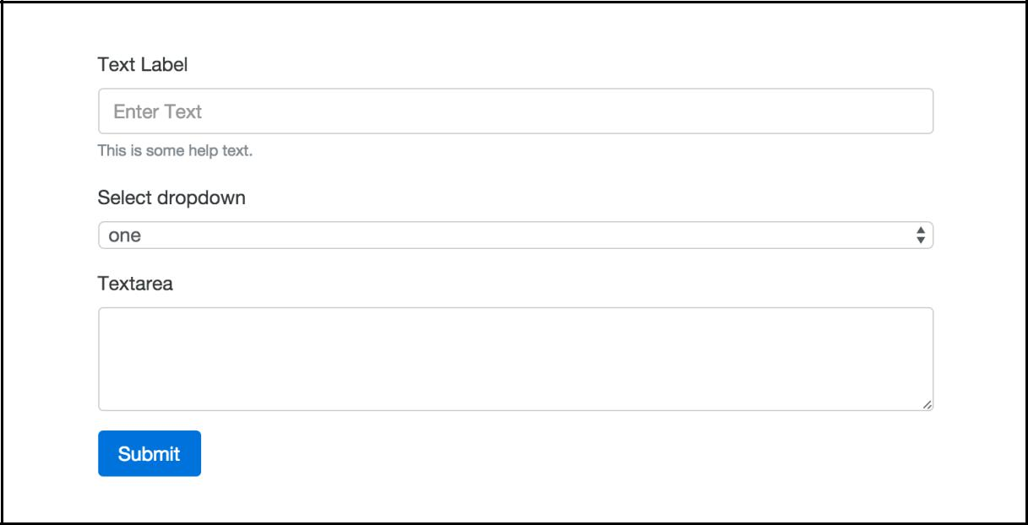
Inserting a textarea tag into your form
Moving along to the next input type, let's insert a <textarea> tag into our form. After the <select> menu, add the following code:

Slide 17


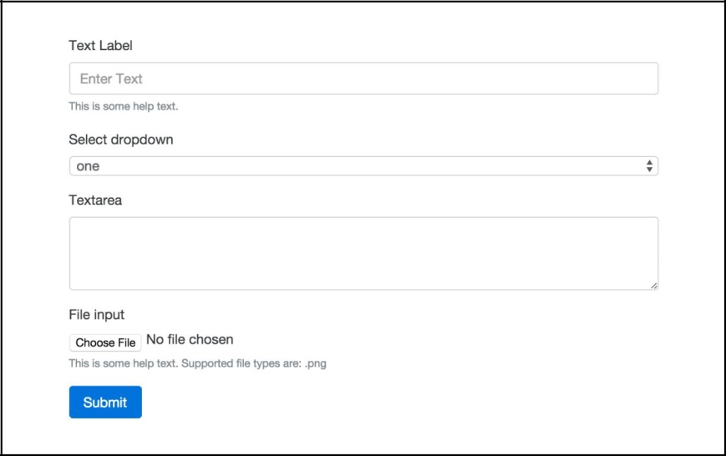
Adding a file input form field
Let's start by inserting the following code after the <textarea> in our form:

Slide 18
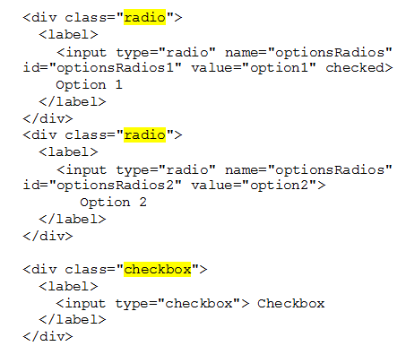
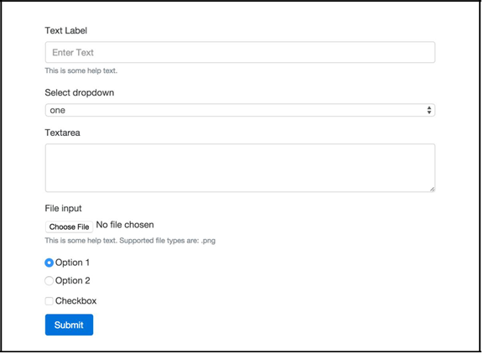
Inserting radio buttons and checkboxes to a form
First, let's insert the following code after the File input field in our form:

Slide 19
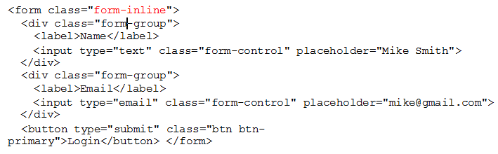

Creating an inline form
Let's start by learning how to create an inline form. This is a layout you might want to use in the header of a project or perhaps for a login page.

Slide 20
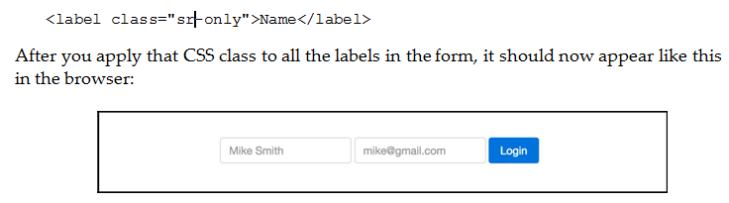
Hiding the labels in an inline form
The reason those labels are there is for accessibility and screen readers. We don't want to remove them altogether from the code, but we can hide them by adding a CSS class named .sr-only.

Slide 21


Adding inline checkboxes and radio buttons
If you'd like to include checkboxes and radio buttons to an inline form you need to make some changes to your code. Let's start by going over the checkbox code. Insert the following code after the last text input in the inline form:

Slide 22
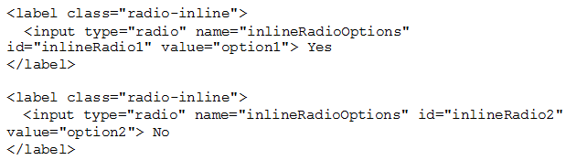

Adding inline checkboxes and radio buttons (tt)
Now that we've added the checkbox, let's check out an example using radio buttons. Add the following code to your form after the checkbox code:

Slide 23
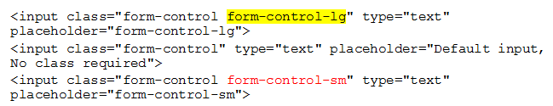
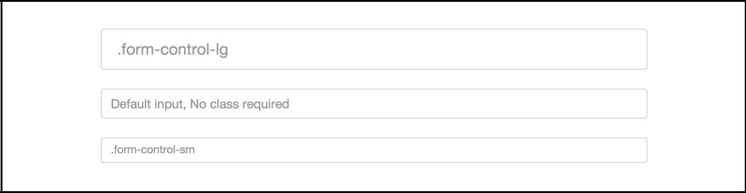
Changing the size of inputs
Bootstrap comes with a few handy utility CSS classes that you can use with form fields to have them appear at different sizes. Along with the default size, you can choose to display your fields in a larger or smaller size.

Slide 24

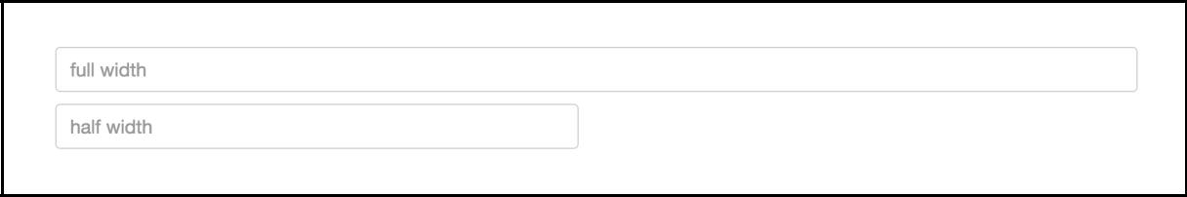
Controlling the width of form fields
If you are using .col-md-12 for your column class, the field is going to stretch to the width of the layout. This may not always be what you want, you may only want the input to stretch to half of the width of the layout.

Slide 25
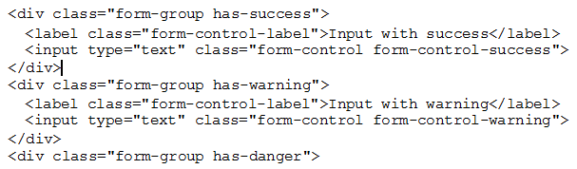

Adding validation to inputs
Bootstrap 4 comes with some powerful yet easy to use validation styles for input fields. Validation styles are used to show things such as errors, warnings, and success states for form fields when you submit the actual form.

Slide 26
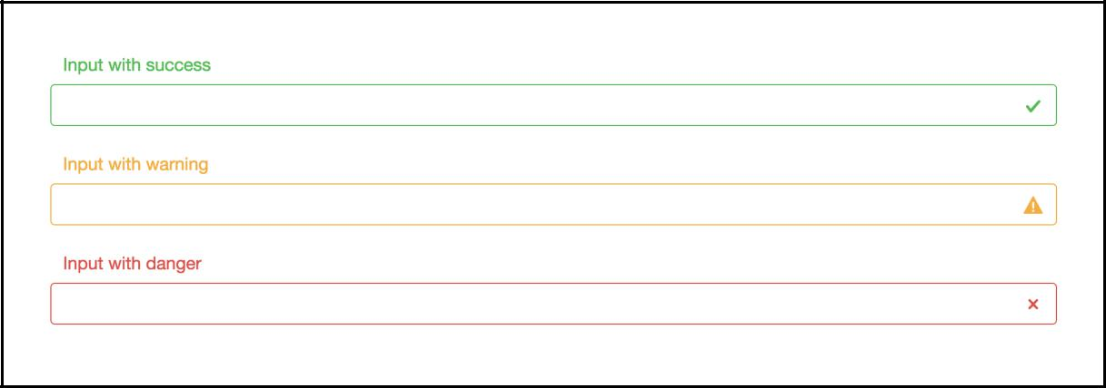
Adding validation to inputs

Slide 27
Using the Jumbotron component
Notes:
Session: Ghi số thứ tự session trong môn học
Session Name: ghi tên của session sẽ dạy

Slide 28
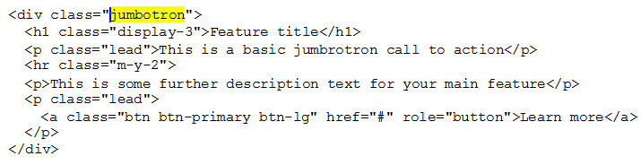
Using the Jumbotron component
Jumbotron is used to feature a block of content, usually at the top of your page. This is your standard main feature block that you'll see on a number of websites. If you require something more sophisticated than a simple page title, Jumbotron is the component you'll want to use.

Slide 29
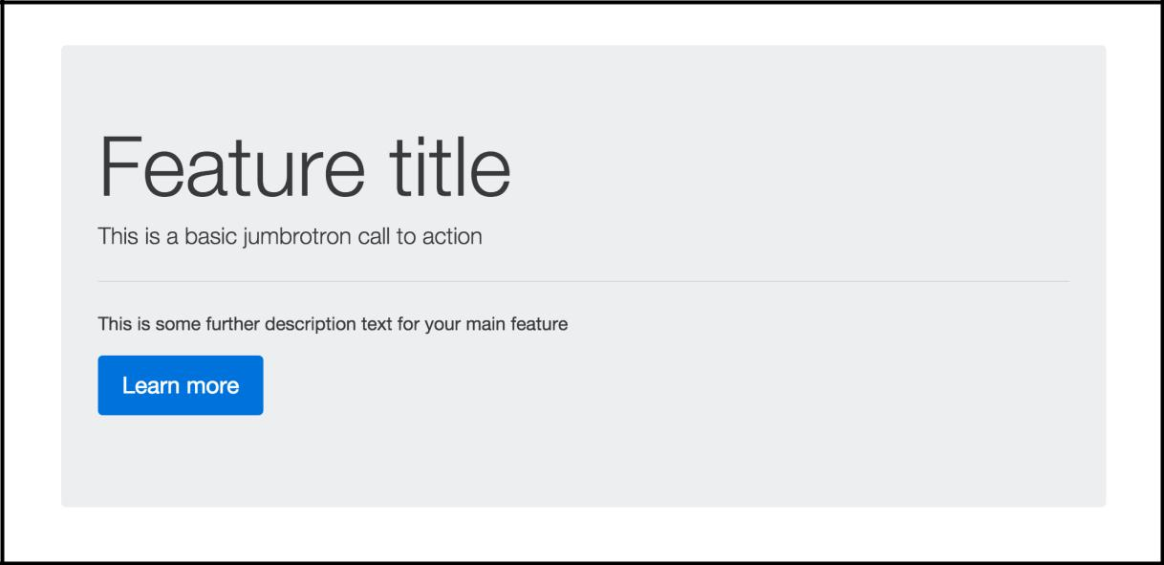
Using the Jumbotron component

Slide 30
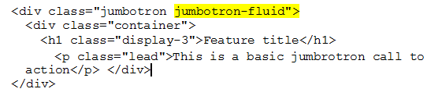
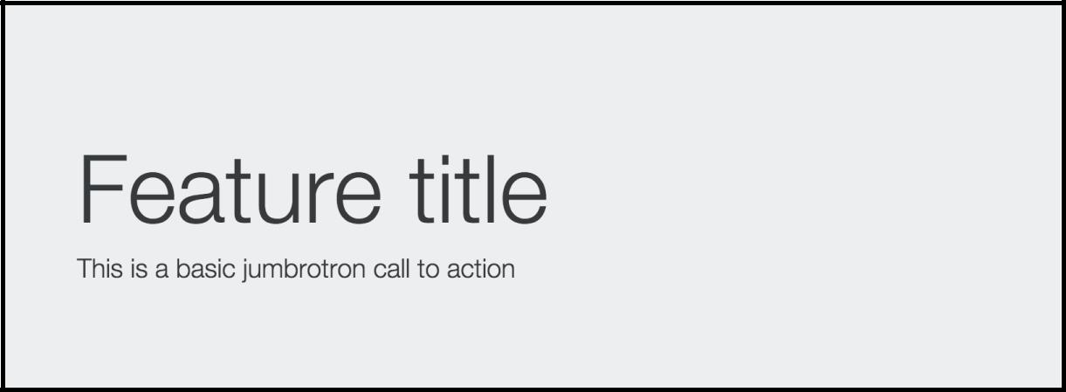
Using the Jumbotron component
By default, the Jumbotron component will stretch to fit the width of the column it is contained within. In some cases, you might want a Jumbotron to stretch from one edge of the browser to the other without any horizontal padding on it.

Slide 31
Using Cards for layout
Notes:
Session: Ghi số thứ tự session trong môn học
Session Name: ghi tên của session sẽ dạy

Slide 32
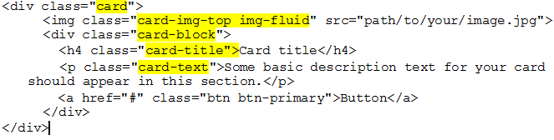
Cards for layout
The best new feature in Bootstrap 4 is the new Card component.
If you're unfamiliar with Cards, they were made popular with the release of Google Material Design. They are a mobile first content container that works well for phones, tablets, and the desktop.

Slide 33
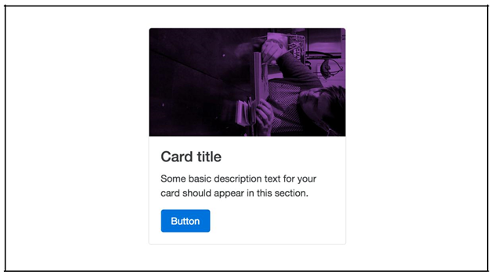
Cards for layout

Slide 34
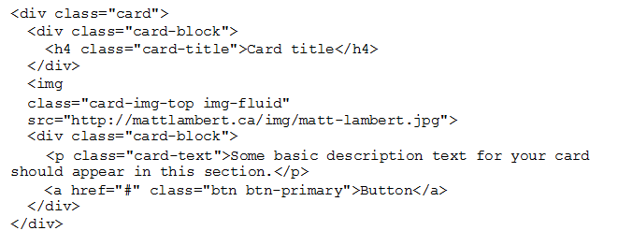
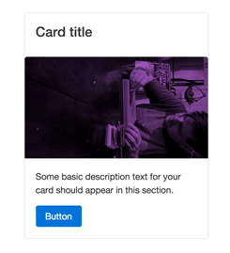
Moving the Card title

Slide 35
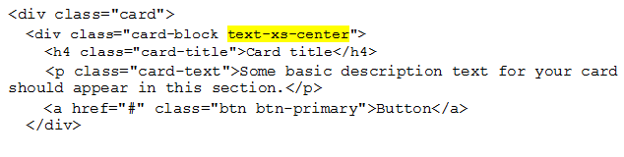
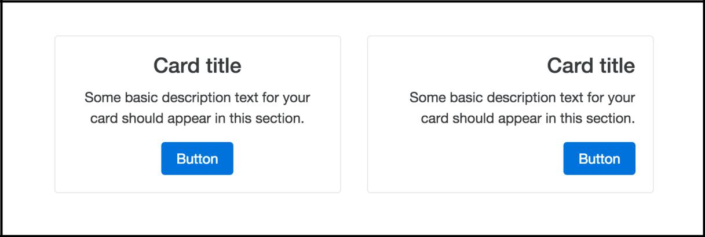
Changing text alignment in cards
I've added a class of .text-xs-center, .text-xs-right

Slide 36
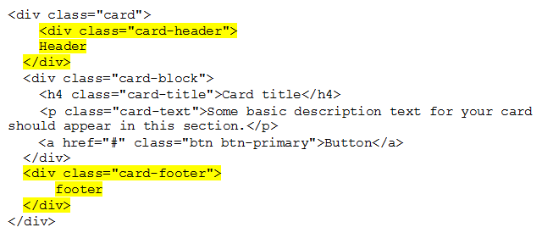
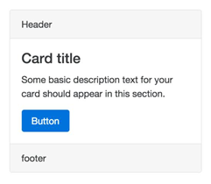
Adding a header, a footer to a Card

Slide 37
How to use the Navs component
Notes:
Chưa cập nhậtND

Slide 38
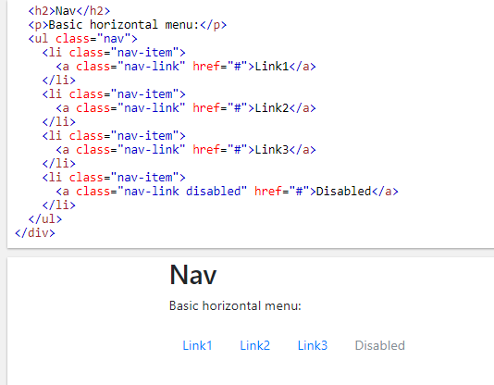
Default Nav component
The Navs component in Bootstrap can be displayed in a couple of different ways. The default view for the component is just a simple unstyled list of links.

Slide 39
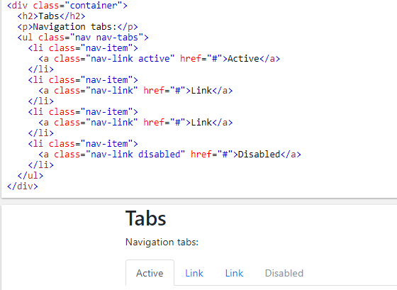
Creating tabs with the Nav component
Converting the basic list to tabs is easy to do by adding a couple of things to our code.
Turn the nav menu into navigation tabs with the .nav-tabs class
Notes:
https://www.w3schools.com/bootstrap4/tryit.asp?filename=trybs_nav_tabs&stacked=h

Slide 40
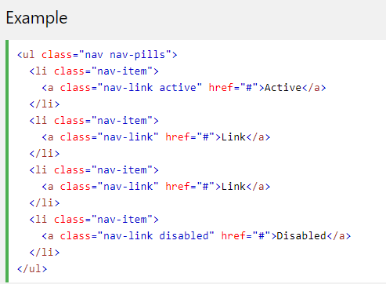
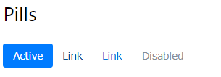
Creating a pill navigation
Changing the style of the Nav component to Pills is actually really easy. Take a look at the following sample code:

Slide 41
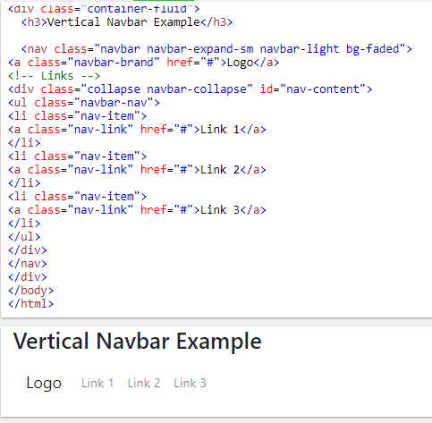
Using the Bootstrap Navbar component
A navigation bar is a navigation header that is placed at the top of the page.
Notes:
<!DOCTYPE html>
<html lang="en">
<head>
<title>Bootstrap Example</title>
<meta charset="utf-8">
<meta name="viewport" content="width=device-width, initial-scale=1">
<link rel="stylesheet" href="https://maxcdn.bootstrapcdn.com/bootstrap/4.0.0-beta.2/css/bootstrap.min.css">
<script src="https://ajax.googleapis.com/ajax/libs/jquery/3.2.1/jquery.min.js"></script>
<script src="https://cdnjs.cloudflare.com/ajax/libs/popper.js/1.12.6/umd/popper.min.js"></script>
<script src="https://maxcdn.bootstrapcdn.com/bootstrap/4.0.0-beta.2/js/bootstrap.min.js"></script>
</head>
<body>
<div class="container-fluid">
<h3>Vertical Navbar Example</h3>
<nav class="navbar navbar-expand-sm navbar-light bg-faded">
<a class="navbar-brand" href="#">Logo</a>
<!-- Links -->
<div class="collapse navbar-collapse" id="nav-content">
<ul class="navbar-nav">
<li class="nav-item">
<a class="nav-link" href="#">Link 1</a>
</li>
<li class="nav-item">
<a class="nav-link" href="#">Link 2</a>
</li>
<li class="nav-item">
<a class="nav-link" href="#">Link 3</a>
</li>
</ul>
</div>
</nav>
</div>
</body>
</html>

Slide 42
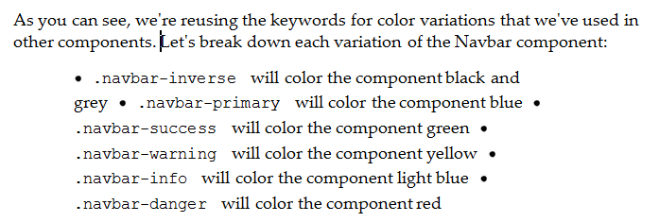
Changing the color of the Navbar

Slide 43
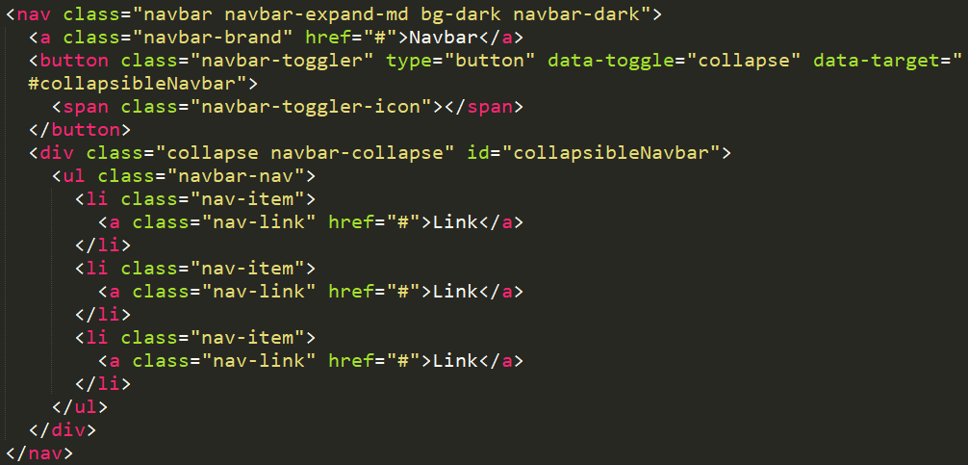
Making the Navbar responsive
Being that Bootstrap is a mobile-first framework, it would only make sense that you need the ability to make the Navbar component responsive.
Notes:
<!DOCTYPE html>
<html lang="en">
<head>
<title>Bootstrap Example</title>
<meta charset="utf-8">
<meta name="viewport" content="width=device-width, initial-scale=1">
<link rel="stylesheet" href="https://maxcdn.bootstrapcdn.com/bootstrap/4.0.0-beta.2/css/bootstrap.min.css">
<script src="https://ajax.googleapis.com/ajax/libs/jquery/3.2.1/jquery.min.js"></script>
<script src="https://cdnjs.cloudflare.com/ajax/libs/popper.js/1.12.6/umd/popper.min.js"></script>
<script src="https://maxcdn.bootstrapcdn.com/bootstrap/4.0.0-beta.2/js/bootstrap.min.js"></script>
</head>
<body>
<div class="container">
<h2>Tabs</h2>
<p>Navigation tabs:</p>
<nav class="navbar navbar-light bg-faded">
<button class="navbar-toggler hidden-sm-up" type="button" data-toggle="collapse" data-target="#responsive-nav">
☰
</button>
<div class="collapse navbar-toggleable-xs" id="responsive-nav"> <a class="navbar-brand" href="#">Navbar</a>
<ul class="nav navbar-inline">
<li class="nav-item active">
<a class="nav-link" href="#">Home</a>
</li>
<li class="nav-item">
<a class="nav-link" href="#">Page 1</a> </li>
<li class="nav-item">
<a class="nav-link" href="#">Page 2</a> </li>
<li class="nav-item">
<a class="nav-link" href="#">Page 3</a> </li>
</ul>
</div>
</nav>
</div>
</body>
</html>

Slide 44
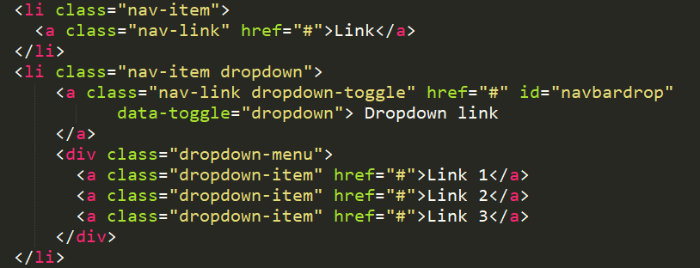
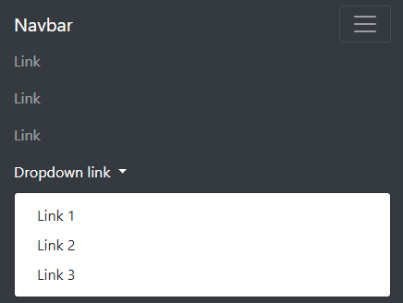
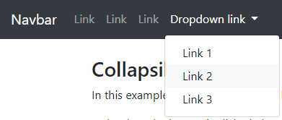
Responsive menu with multiple tier

Slide 45
Summary
This has been a really long chapter but I hope you have learned a lot.
We have covered Bootstrap components including buttons, button groups, button dropdown, forms, input groups, dropdowns, Jumbotron, Label, Alerts, Cards, Navs, Navbar, and List Group.
Notes:
Tóm tắt lại nội dung đã học

